Slide 1

Market Segmentation
Nupoor Karnik
jhr497

Slide 2

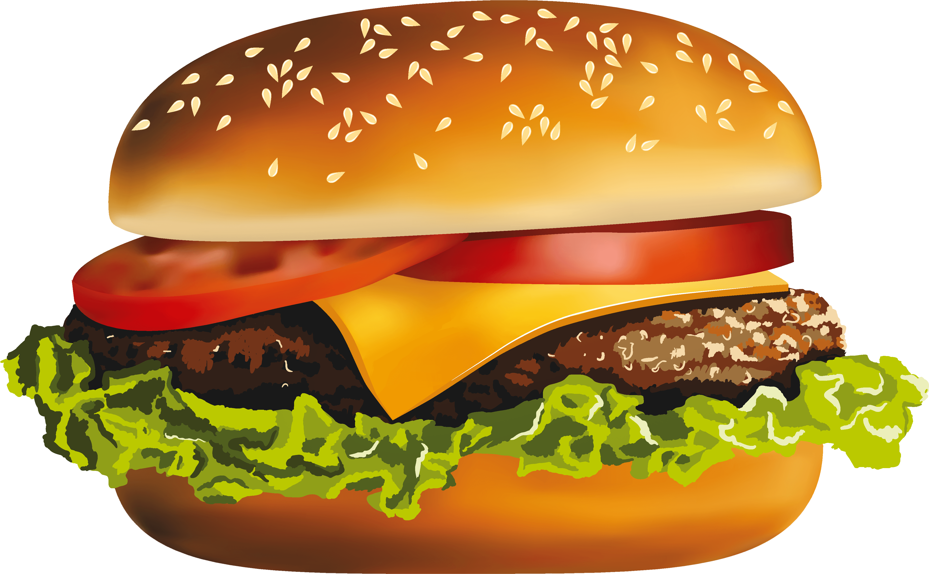

Design Of Market Segmentation
Target Variable

Slide 3
Single Variables
CONSIDER MY DIET TO BE VERY HEALTHY
TOO BUSY TO TAKE CARE OF MYSELF AS I SHOULD
Abstract Variables
1 & 2
Descriptive Variables
McDonald’s
Marital Status
OFTEN EAT STORE-MADE, PRE-COOKED MEALS
IMPORTANT TO BE ATTRACTIVE/OPPOSITE SEX
I MAKE MY CLOTHES LAST A LONG TIME
COMFORT MST IMPRTNT FCTR IN CLTHS I BUY
STICK W/ STYLES HAVE STOOD TEST OF TIME
DRESS TO PLEASE MYSELF
2- TRAVEL- People who travel will eat more chick-fil-a.
1- APPAREL-People who eat chick-fil-a won’t bother/care about styles
VAC. SOMEWHERE DIFFERENT EVERY TIME
I LOVE THE IDEA OF TRAVELING ABROAD
VACATION EXPRNCES DIFFERENTIATE ME/FRNDS
WILLING MAKE TRVL PLAN WITH UNKNWN COMP
Instagram
Nickelodeon
RESPNDNT-SPANISH/HISPANIC/LATINO ORIGIN?
I MAKE SURE I EXERCISE REGULARLY

Slide 4
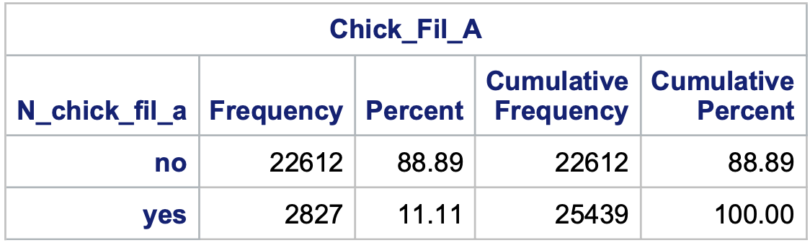
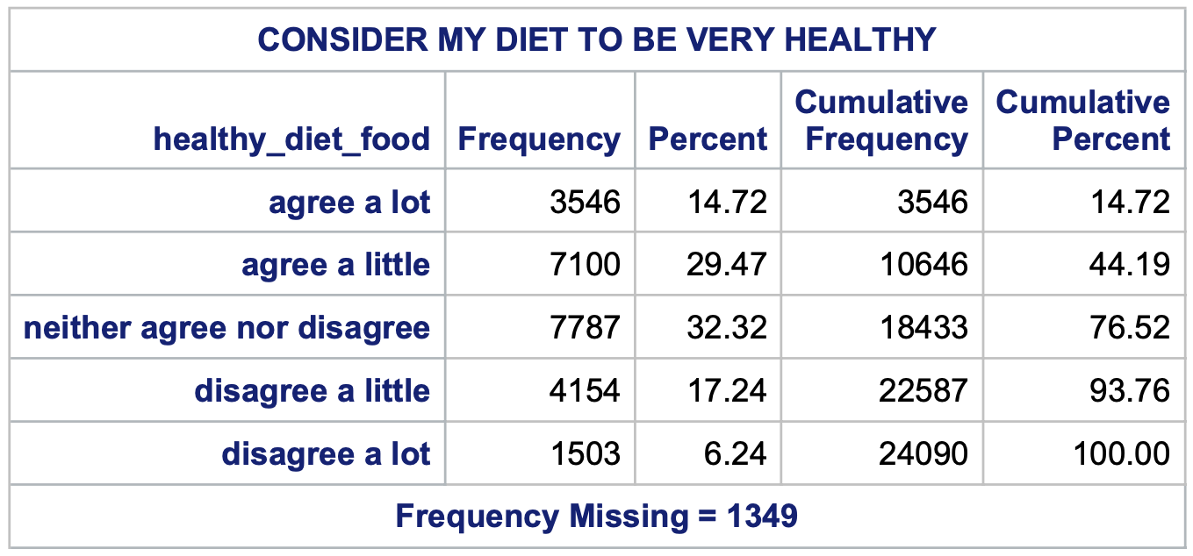
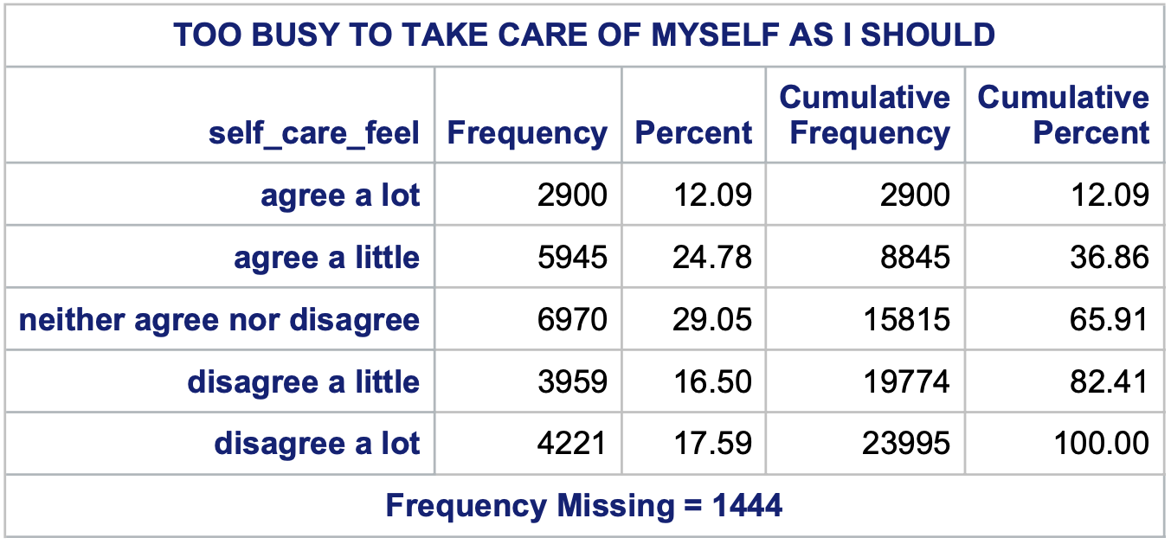
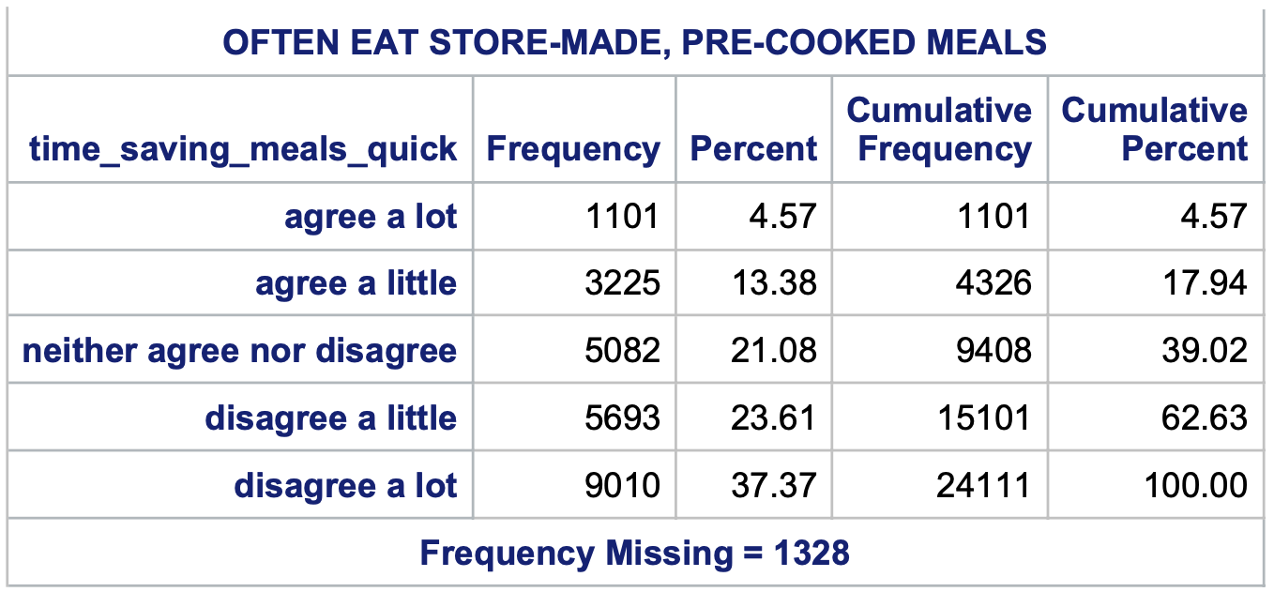
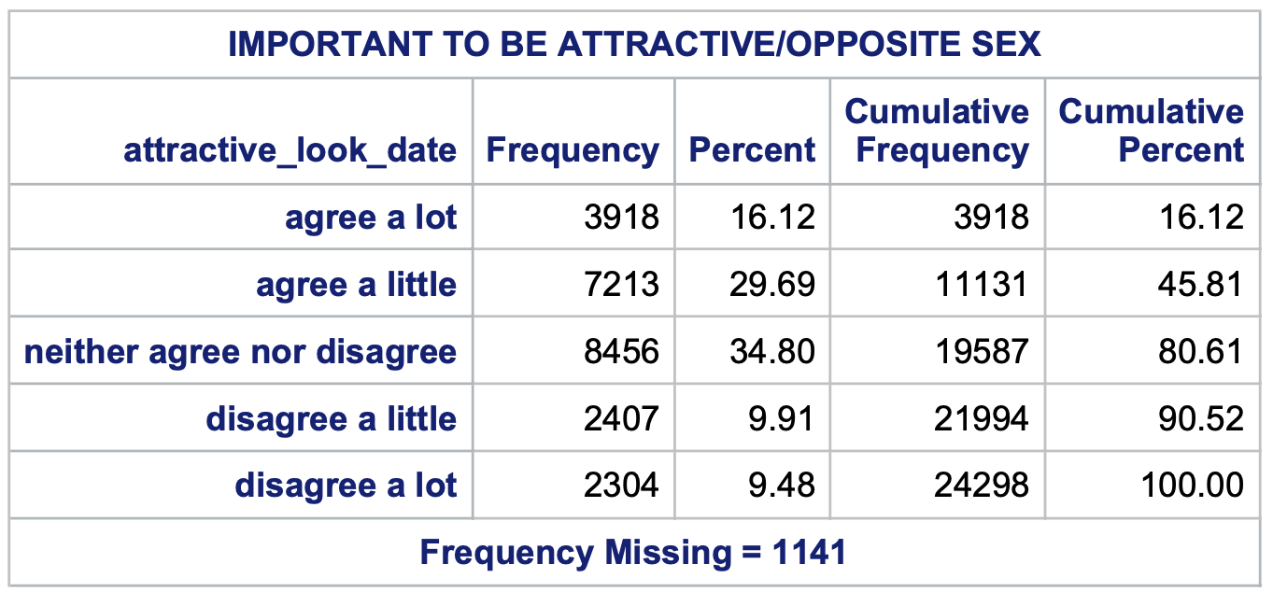
Reading raw data and Creating new Variables

Slide 5
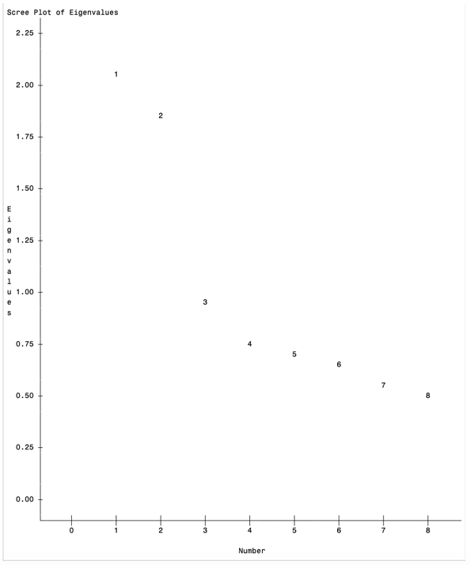
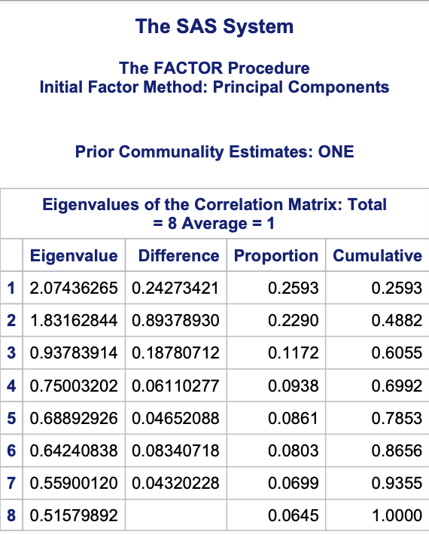
Principal Component Analysis
Extraction Technique –Principle Component Analysis
Rotation Method – Varimax
Criteria for determining factor extraction: Kaiser Criterion(eigen value=>1)
Factors extracted – 2
Variance explained – 48.82%

Slide 6
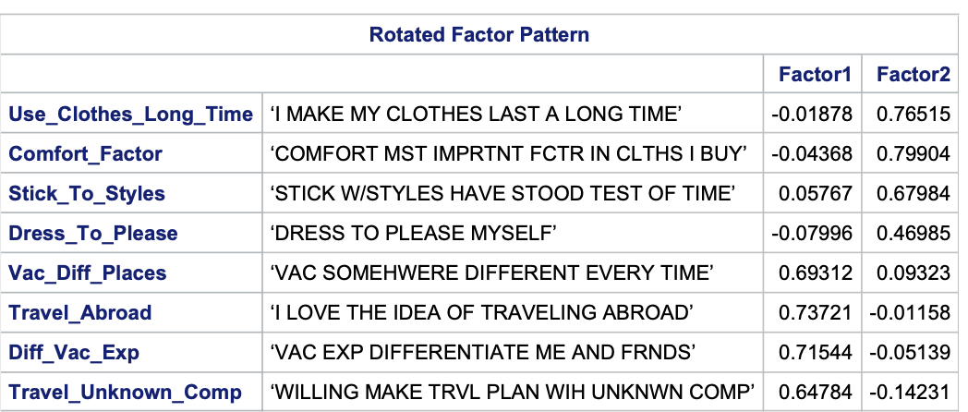

Slide 7
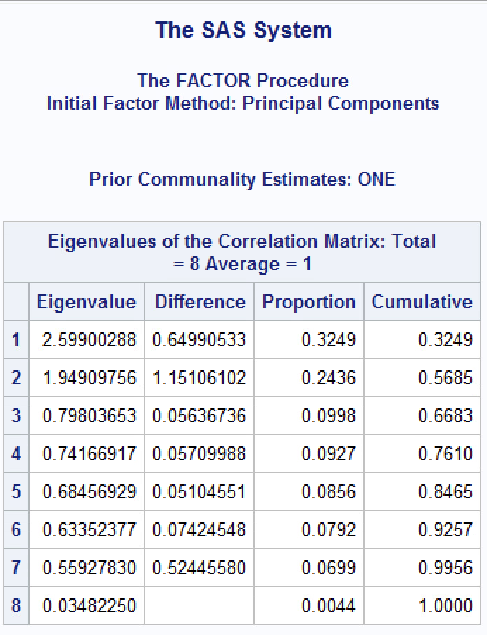
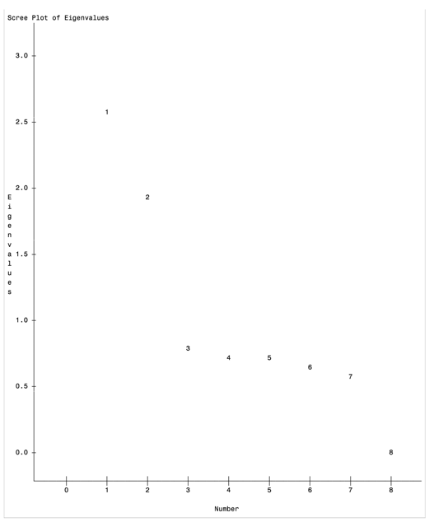
However, because one of the variables- ‘DRESS TO PLEASE MYSELF’ had 0.46985 as a value hence I changed it to ‘FUNCTION MST IMPRTNT FCTR IN CLTHS I BUY’ and following are the revised Eigen values table which shows 2 extracted factors and 56.85% of variance which can be explained, scree plot has a gradient slope and varimax rotation looks good as well.

Slide 8
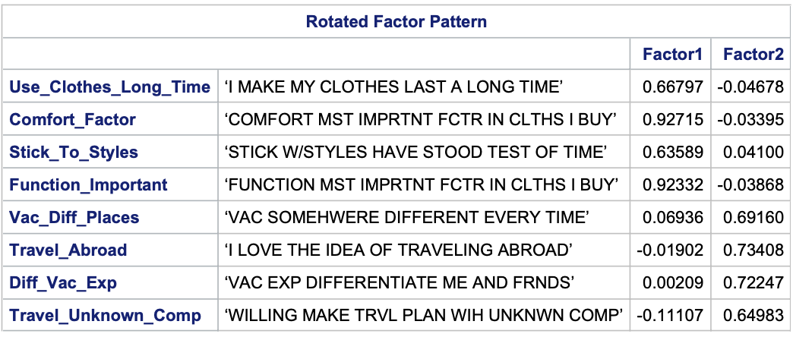

Slide 9
K Means Clustering
K | Number of clusters | R square | CCC | Pseudo F
3 | 3 | 0.26954 | 62.725 | 6106.28
4 | 4 | 0.34856 | 55.321 | 5555.32
5 | 5 | 0.40932 | 44.394 | 5094.47
6 | 6 | 0.44995 | 26.086 | 4477.51
7 | 7 | 0.48563 | 27.45 | 4297.81
8 | 8 | 0.50816 | 24.486 | 3996.41
9 | 9 | 0.52704 | 54.909 | 4140.61
Pseudo f shows cluster 9 as a first local maxima.
CCC shows the local maxima as cluster 7.
R Square for cluster 7 is 48.56%.

Slide 10
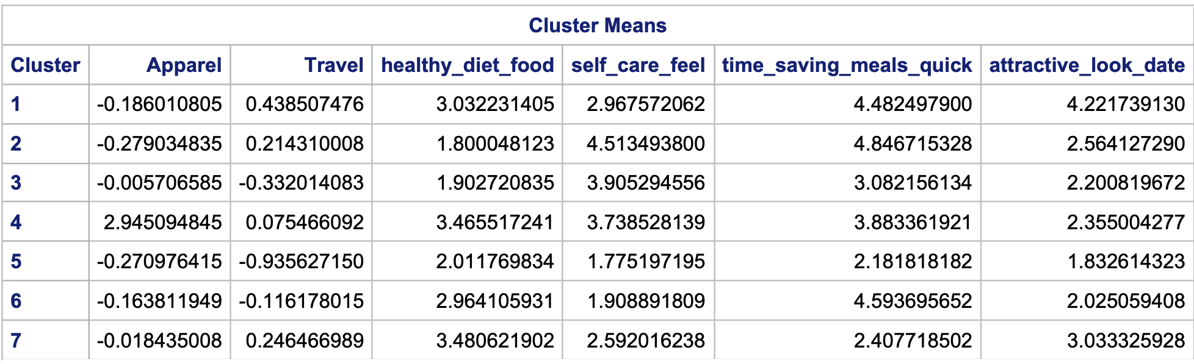
The cluster means show a good solution because the means of single driver variables and abstract constructs have very good spread, and there is discrimination among the cluster means. Following is the post analysis of difference within the cluster variable with (0.1 difference): Combinations Formula-n!/r!(n-r)!= 7!/2!(7−2)!​=21 21*6(single driver+ abstract construct)=126 with 6 ties that is 6/126 which is 4.76%.

Slide 11
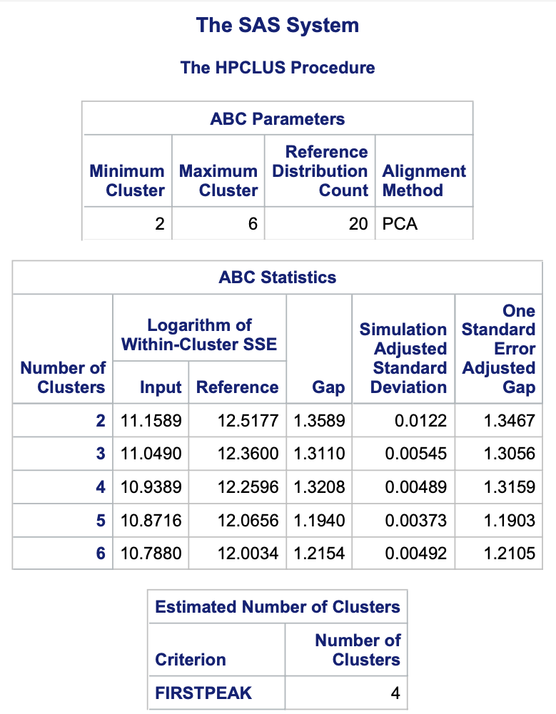
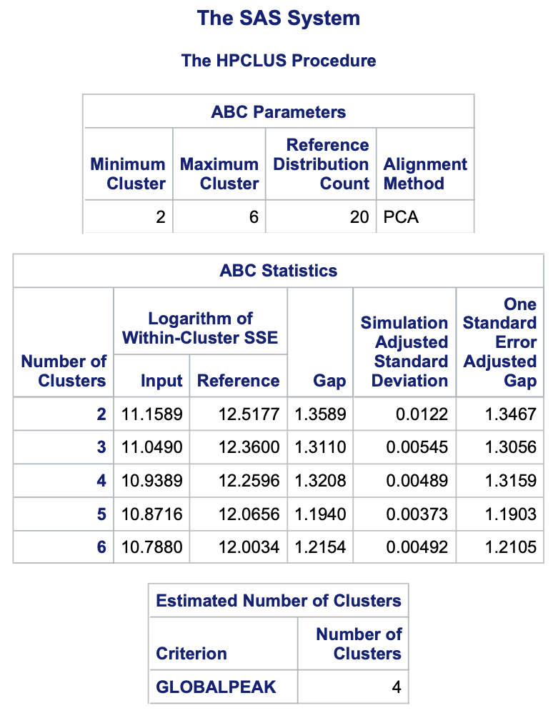
Gap Analysis
For both Firstpeak and Globalpeak the
estimated number of clusters are 4.

Slide 12
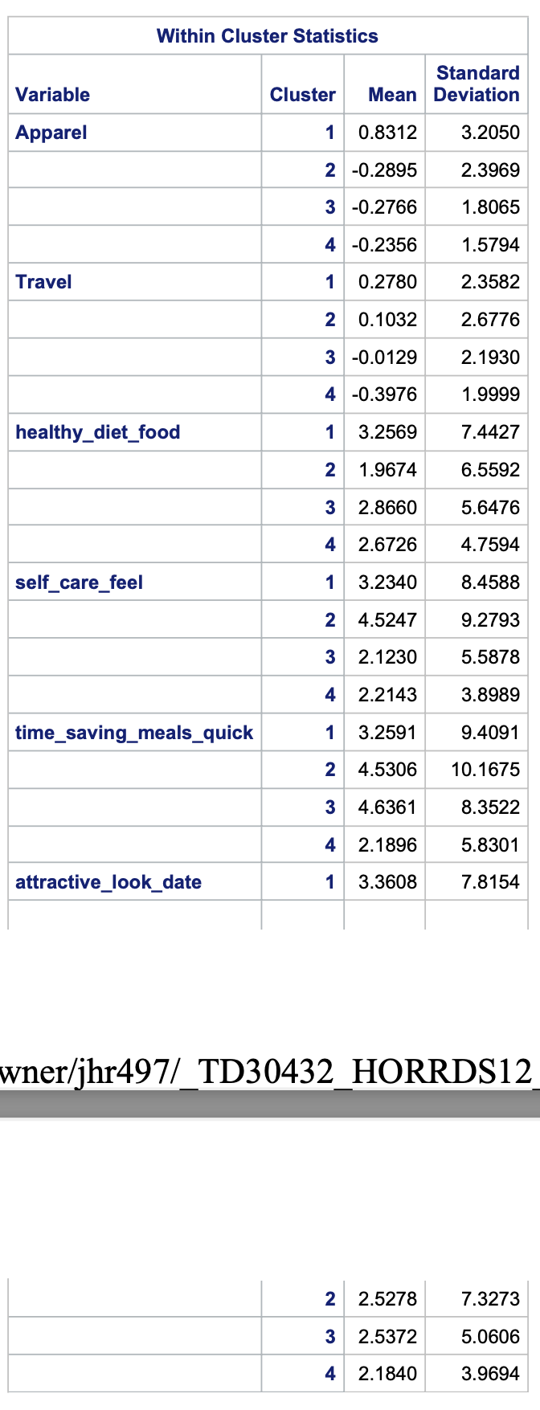
FirstPeak cluster means
Combinations formula:
n! / r!(n-r)! = 4! /2!(4-2)! = 6
6*6 (Driver variables) = 36
0.1 difference:
3 Ties-
3/36 = 8.33%
Hence, based on the firstpeak cluster statistics and combinations formula solution it is seen that there is decent discrimination amongst the cluster means.

Slide 13
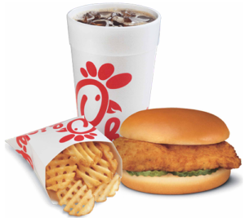






Descriptor Variable Cluster Means

Slide 14
Note: Removed the factor ‘Function Mst Imprtnt Fctr In Clths I Buy’ as it was having the same correlational values as ‘Comfort_Factor’.
After removing it everything worked fine.
Changed the ‘Nickelodeon’ variable to ‘Youtube’ as the mean values for both Nickelodeon and Instagram were very close
and was in turn causing lot of ties in the data which would have caused further issues.
Combinations formula:
n! /r!(n-r)! = 7!/2!(7-2)! = 21
21*7 (descriptor variables) = 147
With 0.1 difference:
3 Ties- 3/147 * 100 = 2.04%
The clustering solution discriminates on
the descriptor variables well.
Descriptors | Cluster=. | Cluster=1 | Cluster=2 | Cluster=3 | Cluster=4 | Cluster=5 | Cluster=6 | Cluster=7
Chick_fil | 0.0495627 | 0.0685484 | 0.0851359 | 0.08318 | 0.0840282 | 0.08723 | 0.0754251 | 0.0851454
Mc_D | 0.1749271 | 0.3096591 | 0.3117163 | 0.2453297 | 0.3746995 | 0.3881128 | 0.3535118 | 0.3418319
Insta | 0.0145773 | 0.0589489 | 0.0983542 | 0.0859779 | 0.0817308 | 0.0873733 | 0.0845945 | 0.115203
Youtube | 0.1516035 | 0.4650687 | 0.4951999 | 0.4865064 | 0.3835792 | 0.416735 | 0.3697202 | 0.4042442
RESPNDNT_ORIGIN | 0.5685131 | 0.2613636 | 0.3373824 | 0.2606347 | 0.3010817 | 0.2648589 | 0.298409 | 0.3862134
MaritalStatus | 0.6916996 | 0.7965642 | 0.7081875 | 0.8001658 | 0.6598947 | 0.7606418 | 0.6650222 | 0.6158279
Regular_Exercise | 1.7272727 | 2.8365773 | 2.6191339 | 2.0703218 | 3.1220412 | 3.3509168 | 2.9411521 | 2.5194546
Notes:
CHICK_FIL: Highest in yellow and lowest in orange
Cluster 5 has the highest mean value of (0.08723) 8.72%, indicating a high preference for Chick_Fil_A.
Cluster 1 has (0.0685484) 6.85% has lowest mean value, suggesting a lower preference.
MCDONALDS:
Cluster 5 has the highest mean value of (0.3881128) 38.81%, indicating a strong preference for McDonalds and lower for Chick_Fil_A.
Cluster 3 shows lowest mean value of (0.2453297)24.53%, suggesting a lower preference for McDonald’s and stronger for Chick_Fil_A.
INSTAGRAM.COM:
Cluster 7 has the highest mean value of (0.115203) 11.52%, indicating a high preference for Instagram and have a high chance of watching ads of Chick_Fil_A on Instagram and would prefer eating at Chick_Fil_A.
Cluster 1 shows lowest mean value of (0.0589489) 5.89%, suggesting a lower preference for using Instagram and further watching ads on it and prefer Chick_Fil_A.
YOUTUBE:
Cluster 2 has the highest mean value of (0.4951999) 49.51%, indicating a strong preference for YouTube indicating higher chance of watching ads on YouTube about Chick_Fil_A and prefer it.
Clusters 6 has (0.3697202) 36.97% has lower mean values and indicates lower preference for using YouTube and in turn having a low chance of eating at Chick_Fil_A.
RESPNDNT_ORIGIN:
Cluster 7 has the highest mean value of (0.3862134) 38.62%, indicating a good proportion from a SPANISH/HISPANIC/LATINO origin prefer Chick_Fil_A.
Clusters 3- (0.2606347) 26.06%, 1- (0.2613636) 26.13% and 5- (0.2648589) 26.48% have comparatively lowest mean values and show low desire to choose Chick_Fil_A.
MARITAL STATUS:
Cluster 3 has the highest mean value of (0.8001658) 80.01%, indicating that a solid amount of married individuals have a strong preference for Chick_Fil_A.
Clusters 7 has (0.6158279) 61.58% has lower mean values and a comparatively lower preference for choosing Chick_Fil_A.
REGULAR_EXERCISE:
Cluster 5 has the highest mean value of 3.350, indicating a strong preference for Chick-Fil_A.
Cluster 3 has 2.070 as the lowest mean values and it indicates lower preference for Chick_Fil_A.

Slide 15
Thank you!

